Slide 1


Department of BES-I
COURSE: Data Structures using Python
COURSE CODE: 24SC1204
Topic:
Name of the topic:
Extendible Hashing
Session – 22

Slide 2



AIM OF THE SESSION
To familiarize students with the basic concept of Double Hashing, Extendible hashing, Rehashing
INSTRUCTIONAL OBJECTIVES
This Session is designed to:
Demonstrate Double Hashing, Extendible hashing, Rehashing
List out the advantages and applications of hashing techniques.
LEARNING OUTCOMES
At the end of this session, you should be able to:
Define Double Hashing, Extendible hashing, Rehashing.
Describe each method.
Summarize definition, types of hashing and its applications

Slide 3
Extendible Hashing
Extendible Hashing is a dynamic hashing method wherein directories, and buckets are used to hash data. It is an aggressively flexible method in which the hash function also experiences dynamic changes.
Frequently used terms in Extendible Hashing
Directories: Instead of using a single hash table, extendible hashing employs a multi-level directory structure.
Buckets: Each directory entry points to a bucket, which stores a subset of key-value pairs.
Local Depth: Each bucket has a local depth, indicating the number of bits from the hash value used for addressing within that bucket.
Global Depth: The directory's global depth determines the maximum number of bits used for addressing.
Bucket Splitting: When the number of elements in a bucket exceeds a particular size, then the bucket is split into two parts.
Directory Expansion: Directory Expansion Takes place when a bucket overflows. Directory Expansion is performed when the local depth of the overflowing bucket is equal to the global depth.

Slide 4
Extendible Hashing
Example: Consider a prominent example of hashing the following elements: 16,4,6,22,24,10,31,7,9,20,26 with bucket Size 3.
Hash Function: Suppose the global depth is X. Then the Hash Function returns X LSBs.
First, calculate the binary forms of each of the given numbers.
16- 10000
4- 00100
6- 00110
22- 10110
24- 11000
10- 01010

Slide 5
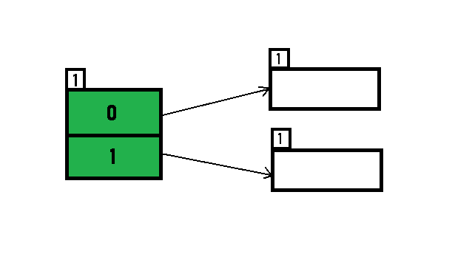
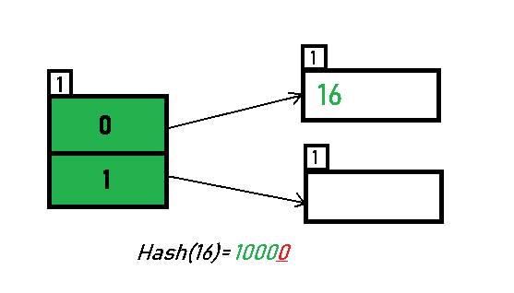
Extendible Hashing
31- 11111
7- 00111
9- 01001
20- 10100
26- 11010
Initially, the global-depth and local-depth
is always 1. Thus, the hashing frame looks
like this:
Inserting 16:
The binary format of 16 is 10000 and
global-depth is 1. The hash function returns 1 LSB of 10000 which is 0. Hence, 16 is mapped to the directory with id=0.

Slide 6
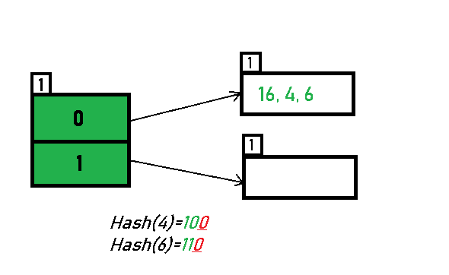
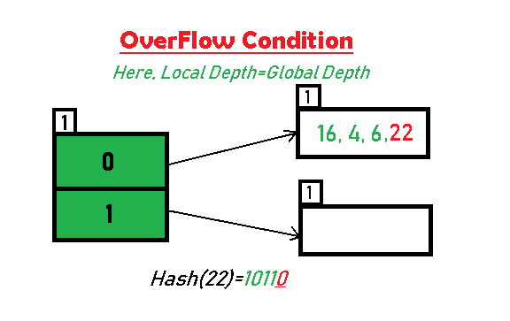
Extendible Hashing
Inserting 4 and 6:
Both 4(100) and 6(110)have 0
in their LSB. Hence, they are hashed
as follows:
Inserting 22: The binary form of 22 is
10110. Its LSB is 0. The bucket pointed
by directory 0 is already full. Hence,
overflow occurs.

Slide 7
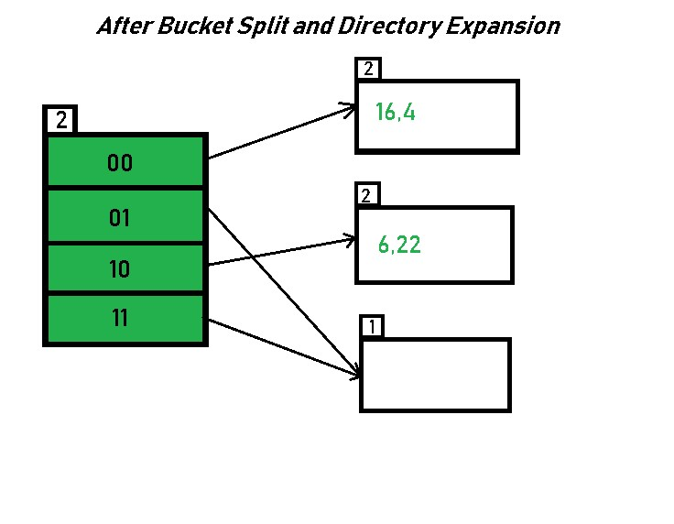
Extendible Hashing
Since Local Depth = Global Depth, the bucket splits and directory expansion takes place. Also, rehashing of numbers present in the overflowing bucket takes place after the split. And, since the global depth is incremented by 1, now,the global depth is 2. Hence, 16,4,6,22 are now rehashed w.r.t 2 LSBs.
[ 16(10000),4(100),6(110),22(10110) ]

Slide 8
IMPORTANT FACTS RELATED TO THE SESSION
Advantages of Double hashing
It can reduce clustering by using a second hash function to determine the next probe location.
It can handle a larger number of collisions than linear probing.
Disadvantages of Double hashing
It can be more complex to implement and understand than linear or quadratic probing
Advantages of Rehashing
Handling collisions: As mentioned above, rehashing is primarily used to handle collisions in hash tables. ...
Improving performance: Rehashing can also be used to improve the performance of hash
tables
Advantages of Extendible Hashing
Data retrieval is less expensive (in terms of computing).
Very flexible in choosing size of bucket and alllows storage on disks/remote memory access.
Disadvantages of Extendible Hashing
Increased algorithm complexity
Extra memory overhead to store index inside the bucket.

Slide 9
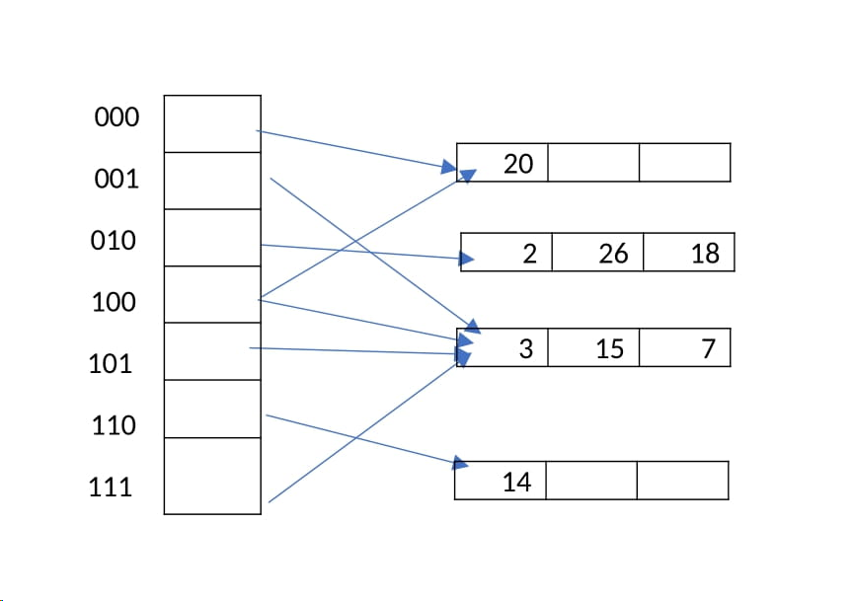
EXAMPLES
Consider an extendible hashing structure that, each bucket can hold up to 2 records. Is initially empty (only one empty bucket). Consider the result after inserting keys 8, 16, 4, 3, 11, 12 in order, using the lowest bits for the hash function. That is records in a bucket of local depth d agree on their rightmost d bits. For example, key 4 (0100) and key 12(1100) agree on their rightmost 3 bits (100). What is the global depth of the resulting directory? Now insert key 18. What is the local depth of the bucket that contains key 18?

Slide 10
IMPORTANT FACTS RELATED TO THE SESSION
Applications of rehashing in real life
Password Verification
Data Structures
File System.
Applications of Extendible Hashing
All modern file systems use extendible hashing.
Applications of Double Hashing
To prevent the collision of two keys ,the idea of Double Hashing is used. In case any collision occurs when we just use traditional hash code evaluating function, another hash code is generated by some other function and both the hash codes are used to find a free space by probing through array elements.

Slide 11
SUMMARY
Double hashing:It is a technique in which two hash function are used when there is an occurrence of collision.
The hash functions for this technique are:
H1(key)= (key % table size + i * H2(key))% table size
Whereas H2(key)=P-(key mod P); i=0,1..<size
Rehashing is the process of increasing the size of a hashmap and redistributing the elements to new buckets based on their new hash values. It is done to improve the performance of the hashmap and to prevent collisions caused by a high load factor.
Extendible Hashing is a dynamic hashing method wherein directories, and buckets are used to hash data. It is an aggressively flexible method in which the hash function also experiences dynamic changes.
Number of Directories = 2^Global Depth.

Slide 12
SELF-ASSESSMENT QUESTIONS
1. What is the hash function used in Double Hashing?
a) (h1(k) – i*h2(k))mod m
b) h1(k) + h2(k)
c) (h1(k) + i*h2(k))mod m
d) (h1(k) + h2(k))mod m
2. Double hashing is one of the best methods available for open addressing
a) True
b) Falseny point

Slide 13
TERMINAL QUESTIONS
1. What is Load factor?
2. When is rehashing done?
3. What is local depth, global depth?

Slide 14
REFERENCES FOR FURTHER LEARNING OF THE SESSION
Reference Books
Data Structures and Algorithm Analysis in PYTHON, 2010, Mark Allen Weiss, Second Edition, Pearson Education.
Data Structures and Algorithms, A.V.Aho, J.E.Hopcroft, and J.D.Ullman, Pearson Education, First Edition Reprint2003.
Advanced Guide to Python 3 Programming, John Hunt, 4th Edition, Springer Nature Switzerland AG 2019.
Python Basics: A Practice Introduction to Python 3, David Amos, Dan Bader, Joanna Jablonski, Fletcher Heisler, 4th edition, Real Python
.Sites and Web links:
https://docs.python.org/3/tutorial/datastructures.html
https://www.w3schools.com/dsa/dsa_intro.php
3. https://www.geeksforgeeks.org/python-data-structures/

Slide 15
THANK YOU
Team – Data Structures using Python

